Slide 1

IPE 331: Production Processes
Rolling
Mostofa Habib Fardin
Lecturer, Dept. of IPE, BUET
Email: fardin@ipe.buet.ac.bd
Textbooks:
  Kalpakjian, Serope & Schmid, Steven R. — Manufacturing Engineering and Technology, 6th Edition
  Groover, Mikell P. — Fundamentals of Modern Manufacturing: Materials, Processes, and Systems, 4th Edition

Slide 2
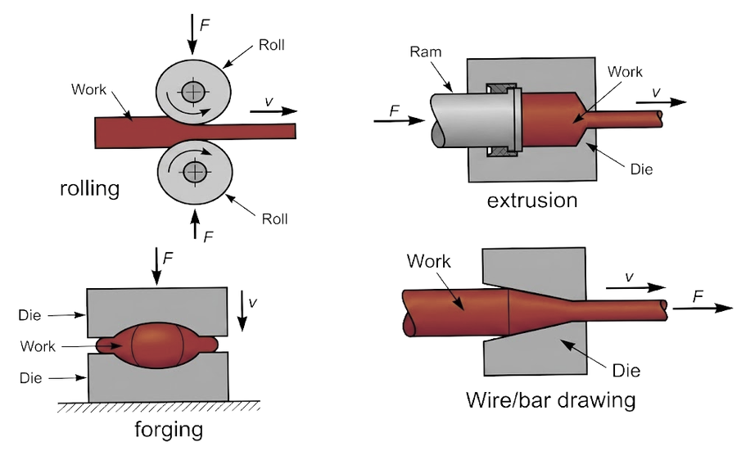
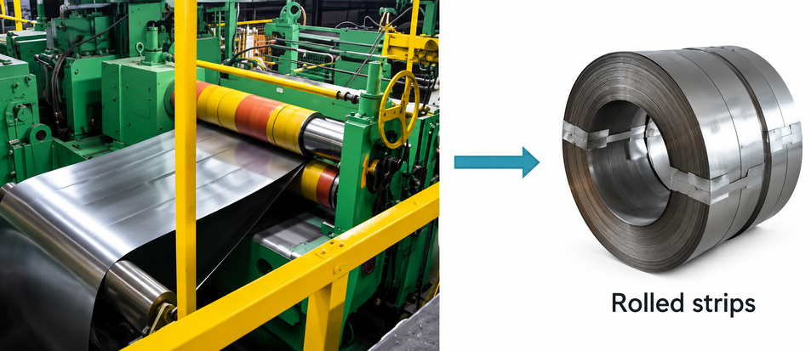
Introduction to Rolling
Definition: Rolling is a bulk deformation process that reduces the thickness or changes the cross-section of a long workpiece by passing it between a pair of rotating rolls that apply compressive force.
  Analogous to rolling dough with a rolling pin: the rolls squeeze the material and simultaneously pull it forward through friction
  Rolling accounts for roughly 90% of all metal tonnage processed by metalworking, making it the highest-volume shaping process in industry
  First developed in the late 1500s; modern rolling mills descend directly from that basic two-roll concept
  The basic operation is flat rolling, which produces flat plate and sheet stock. There is also shape rolling, which produces profiles
Figure 1 : Rolling
2

Slide 3
Plate vs. Sheet
Plates and sheets are the two flat-rolled product categories, distinguished by thickness.
  Plate: thickness greater than 6 mm. Used for structural applications where load-bearing capacity matters more than formability
    Boiler supports: up to 0.3 m thick,
    reactor vessels: around 150 mm,
    battleship and tank armor: 100–125 mm
  Sheet: thickness less than 6 mm. Supplied as flat pieces or as coiled strip for further processing
    Commercial aircraft fuselage skin: minimum 1 mm aluminum alloy sheet,
    aluminum foil (the thinnest rolled product in common use): 0.008 mm
    A sheet metal gauge is a standardized number system used to measure the thickness of sheet metal.
3

Slide 4
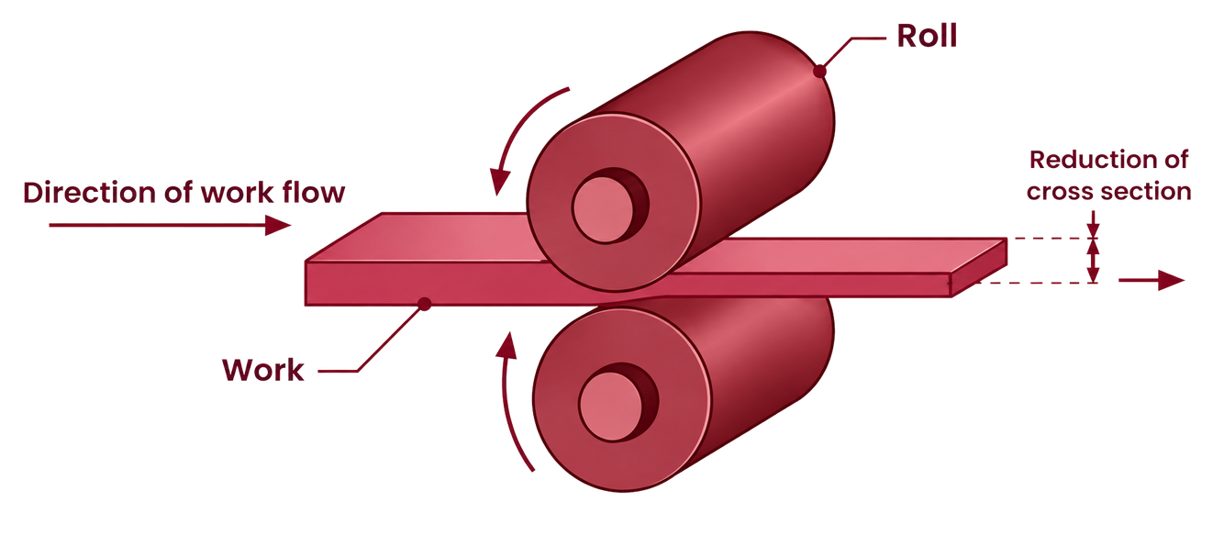
The Rolls
  Function: Rotating rolls perform two functions simultaneously:
    they pull the workpiece into the roll gap by friction,
    and they compress it to reduce the cross-section.
  Friction at the roll-workpiece interface is not incidental; it is the mechanism that feeds the strip through. No friction, no rolling.
Figure 2 : Rolls in rolling operation.
4

Slide 5
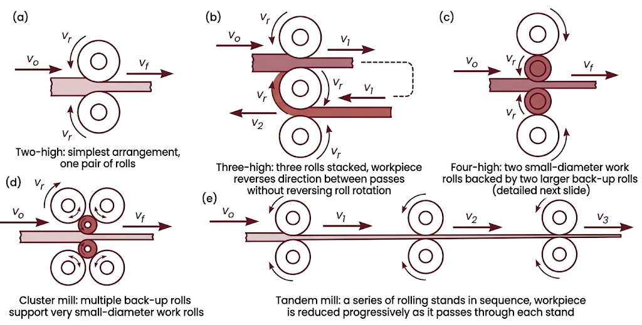
Mill Configurations Overview
  Five standard rolling mill arrangements, distinguished by roll count and stand sequencing:
Figure 3 : Rolling Mill Configurations
5

Slide 6
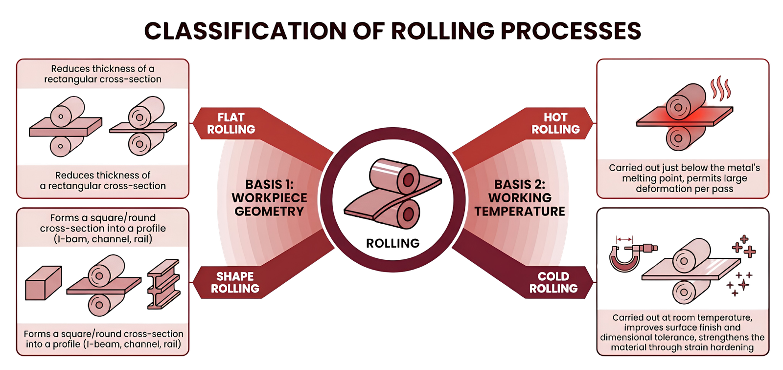
Rolling classification
  Rolling is classified two ways: by workpiece geometry, and by working temperature.
Figure 4 : Rolling Classification
6

Slide 7
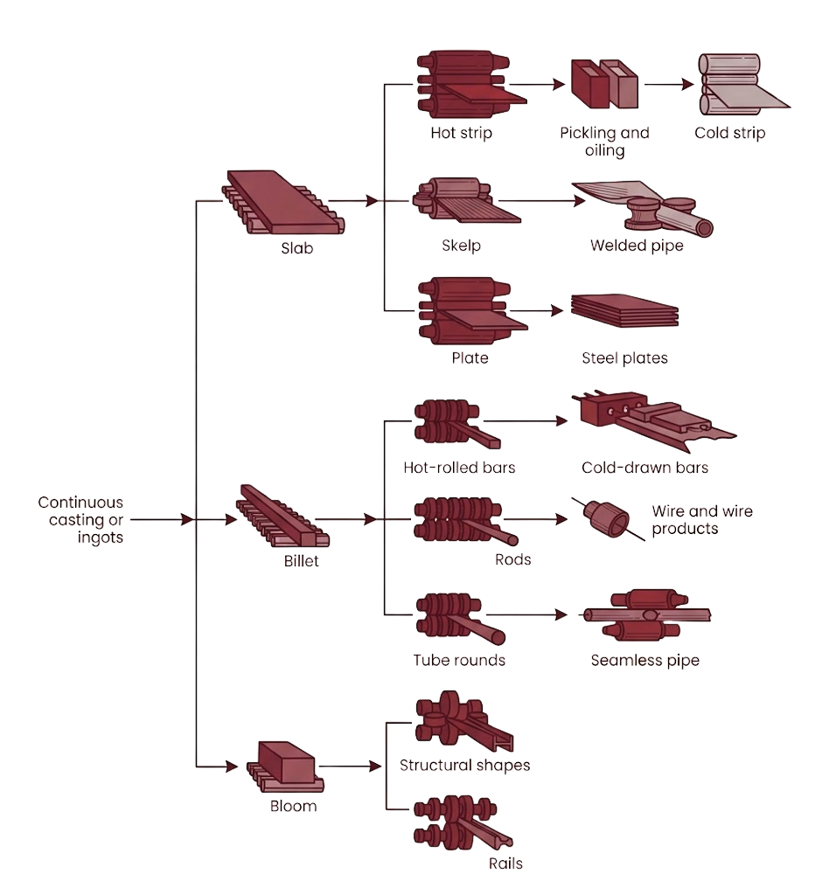
Flat-Rolling and Shape-Rolling Process Flow
  Overview of how continuously cast or ingot-cast stock is broken down into blooms, billets, and slabs, then rolled downstream into final products
  Slab → plate, skelp, hot strip → cold strip, welded pipe
  Billet → bars, rods → wire, seamless pipe
  Bloom → structural shapes, rails
Figure 5 : Schematic outline of various flat-rolling and shape-rolling processes.
7

Slide 8
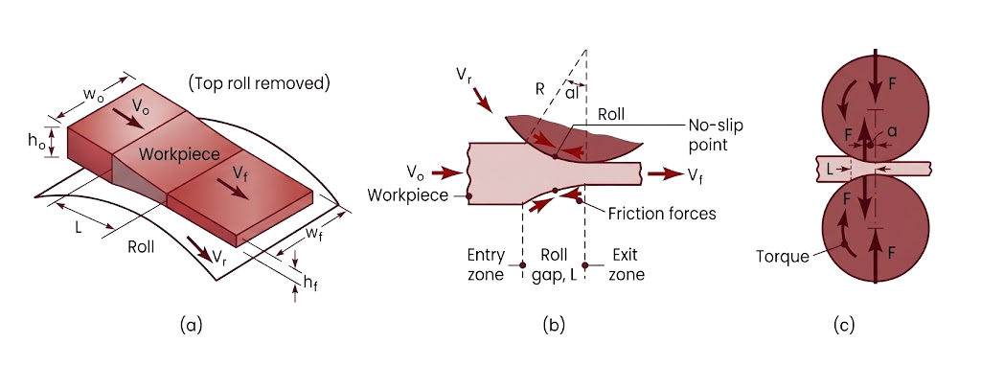
Roll Gap Geometry and Draft
  A metal strip of entry thickness ho​ enters the roll gap and exits at reduced thickness hf ​, driven by a pair of rolls of radius R, each independently powered by an electric motor
  Draft, d: It is the reduction in thickness produced by a rolling pass: d=ho−hf
  Notation: ho = entry thickness, hf = exit thickness, R = roll radius, L = roll-strip contact length, w = strip width.
Figure 6 : (a) Schematic illustration of the flat-rolling process. (b) Friction forces acting on strip surfaces. (c) Roll force F and torque T acting on the rolls. The width of the strip, w, usually increases during rolling
8

Slide 9
Friction Force and the No-Slip Point
Friction force: It is the net frictional traction between the roll surface and the workpiece that pulls the strip into the roll gap.
  This friction-limited feeding sets an upper bound on how much draft can be taken in a single pass:
dmax= ho - hf = μ2R
  where μ is the coefficient of friction between roll and workpiece. A higher μ or a larger roll radius R permits a larger maximum draft.
No-Slip Point (Neutral Point): Along the arc of contact, the roll surface velocity and the strip velocity are equal at exactly one point: the no-slip point. Before it, the roll moves faster than the strip; after it, the strip moves faster than the roll. Vital for:
  Friction Pivot: Marks where friction reverses from pulling metal in to pushing it out.
  Peak Pressure: Identifies the exact spot of maximum compressive roll force.
  Process Stability: Prevents the mill from stalling by keeping the rolls gripped to the metal.
  Wear Reducer: Minimizes relative sliding, reducing energy loss and roll wear.
  Gauge Control: Dictates forward slip used to adjust strip thickness and tension.
9

Slide 10
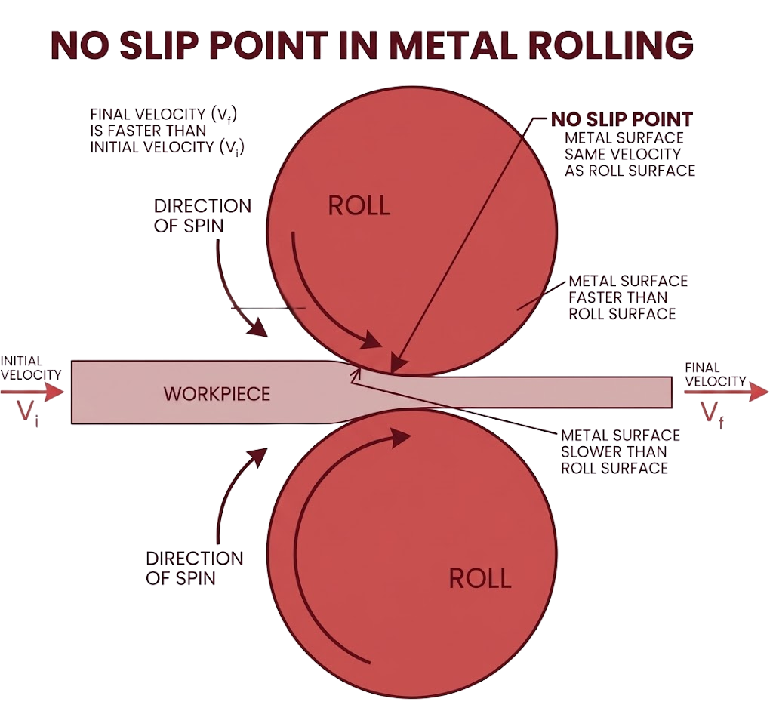
No-Slip Point in Metal Rolling
Figure 7 : No-Slip Point in Metal Rolling
10

Slide 11
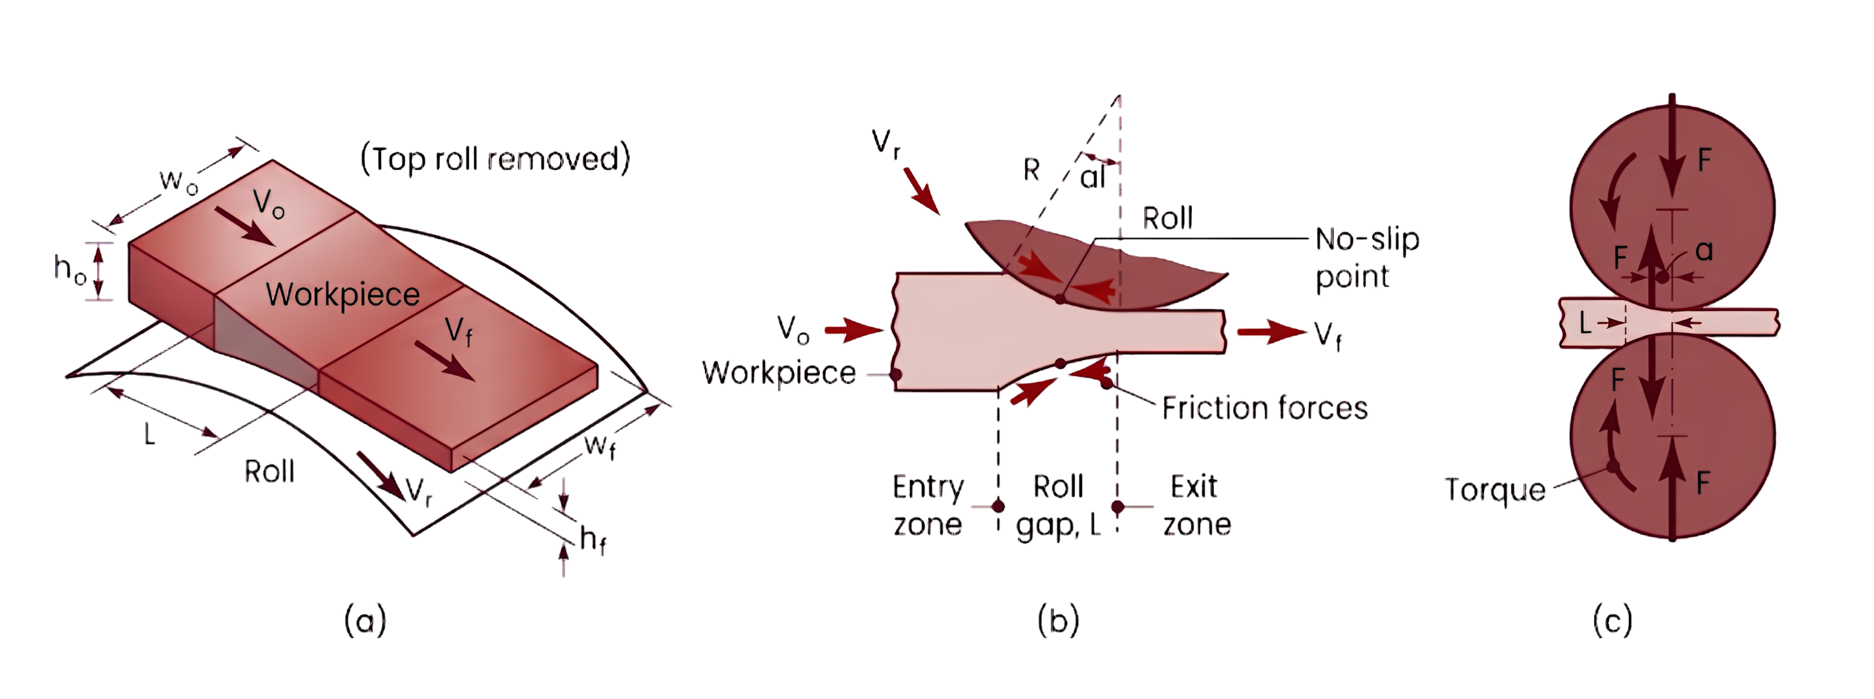
Roll Force and Torque
  Roll force, F, is the force the rolls apply perpendicular to the arc of contact to achieve the thickness reduction; torque, T, is the moment each roll's drive motor must supply to rotate the roll against this force.
  Both act on each roll, and both must be accounted for in mill design, since roll force determines the stand's structural loading, and torque determines motor sizing
  High roll force causes the rolls to deflect and flatten elastically under load, which degrades control over the final strip thickness
  Controlling roll force is therefore a mill design and process planning problem.
Figure 8 : Roll force F and torque T acting on the rolls.
11

Slide 12
Methods of Reducing Roll Force
  Roll force can be reduced by any of the following:
    Reducing friction at the roll-strip interface
    Using smaller-diameter rolls, which reduces contact area (this is the logic behind the four-high mill)
    Taking a smaller reduction (draft) per pass, which also reduces the contact area
    Rolling at elevated temperature, which lowers the material's flow stress
    Applying longitudinal tension to the strip during rolling
  Tension is especially important when rolling high-strength metals, which otherwise demand very high roll forces
  Tension can be applied at the entry zone (back tension), the exit zone (front tension), or both
12

Slide 13
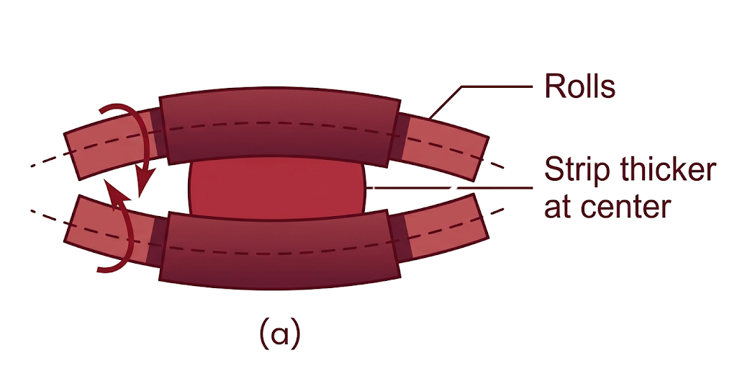
Roll Bending
  Roll bending is the elastic deflection of the rolls under roll force.
  A higher elastic modulus in the roll material means smaller deflection for the same roll force
  Consequence: straight cylindrical rolls under load produce a strip that is thicker at the center than at the edges, since the rolls bow apart more in the middle
Figure 9 : Bending of straight cylindrical rolls caused by roll forces.
13

Slide 14
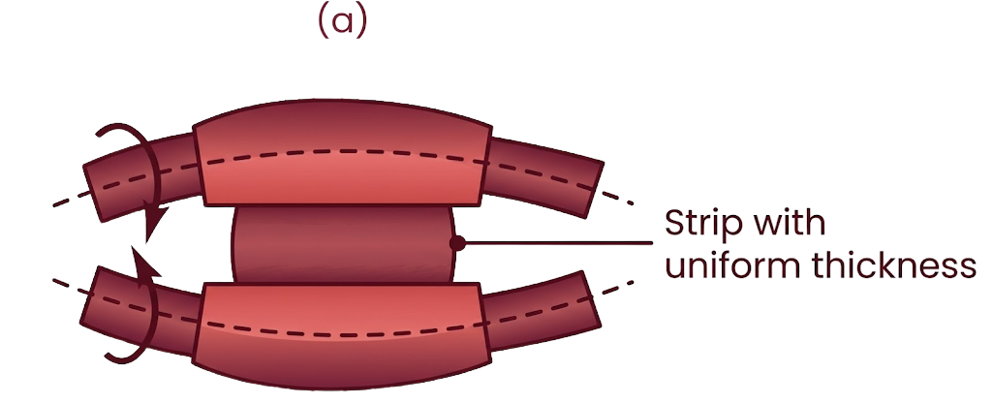
Camber to Fix Roll Bending
Definition: Camber is a deliberate, slight barrel-shaped grinding of the roll (rolls ground with a larger diameter at the center) that compensates for the expected elastic bending under load.
  Under load, a cambered roll deflects into an effectively straight (uniform-gap) profile, producing a strip of uniform thickness across its width
  Camber is calculated for a specific expected roll force. Running the mill outside that force range reintroduces the thickness variation camber was meant to fix
Figure 10 : Bending of rolls ground with camber, producing a strip with uniform thickness through the strip width.
14

Slide 15
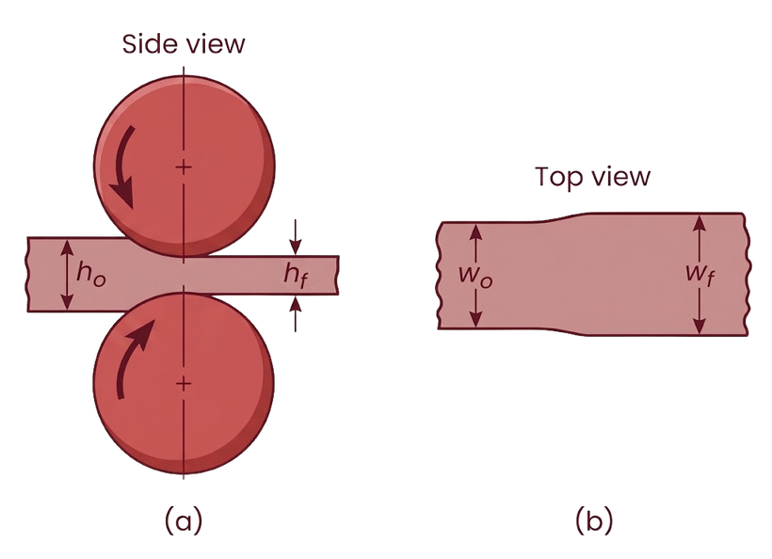
Spreading
Definition: Spreading is the increase in strip width that occurs as a workpiece passes through the rolls, in addition to the intended reduction in thickness.
  In rolling plates and sheets with a high width-to-thickness ratio, the width stays effectively constant since the material has little room to flow sideways relative to its width
  With a low width-to-thickness ratio (e.g. a square cross-section), the width constraint is weaker and the material flows outward, this is spreading, the same effect seen when dough is rolled with a rolling pin
  Spreading increases with: (a) decreasing width-to-thickness ratio of the entering strip, (b) increasing friction, (c) decreasing ratio of roll radius to strip thickness
  Spreading can be suppressed by placing vertical edge rolls in contact with the sides of the strip, physically constraining the lateral flow
Figure 11 : Increase in strip width (spreading) in flat rolling.
15

Slide 16
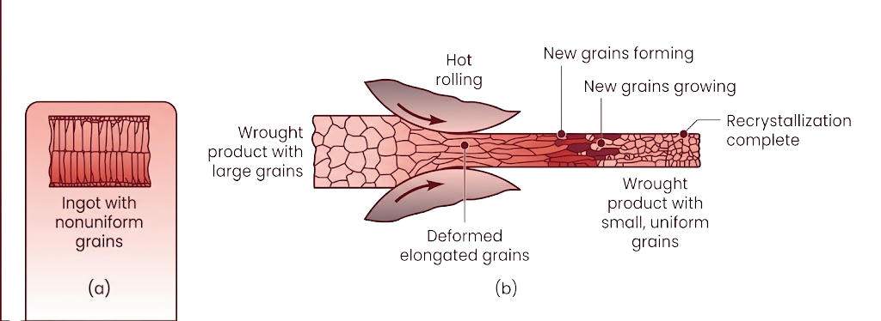
Flat Rolling Practice: Hot Rolling
Definition: Hot rolling is the initial breakdown of cast material into wrought form, carried out at a temperature high enough to permit large plastic deformation without cracking.
  Converts the cast structure into a wrought structure, characterized by finer, more uniform grains and higher ductility
  Mechanism: hot working breaks up the brittle, columnar grain boundaries inherent to as-cast metal, and closes up internal porosity through plastic deformation. Recrystallization at the hot-working temperature then replaces the deformed grains with new, small, equiaxed grains
  This is why hot rolling is standard practice for improving strength and ductility in cast ingots or continuous-cast slabs before any further processing
Figure 12 : Changes in the grain structure of cast or of large-grain wrought metals during hot rolling.
16

Slide 17
Bloom, Billet, Slab
The product of the first hot-rolling pass on an ingot or continuous cast is one of three intermediate shapes:
Shape | Cross Section | Rolled Into
Bloom | Square, ≥ 150 mm/side (≥ 6" × 6") | Structural shapes
Billet | Square, smaller than bloom, ≥ 1.5" × 1.5" | Bars, rods
Slab | Rectangular, ≥ 10" × 1.5" | Plates, sheets, strip
  Before further rolling, the surface of blooms, billets, and slabs is conditioned, prepared for the next operation via scale removal, rough grinding, acid etching, or water blasting
17

Slide 18
Cold Rolling and Pack Rolling
Cold Rolling: Cold rolling is a rolling operation carried out at room temperature, typically applied after hot rolling when a better surface finish and tighter dimensional tolerance are required.
  Compared with hot rolling, cold rolling delivers:
    Better surface finish (no oxide scale forms at room temperature)
    Tighter dimensional tolerances
    Improved mechanical properties, via strain hardening
  Trade-off: strain hardening increases strength but also increases the force required for further deformation. This is why cold rolling is typically the final finishing step rather than the initial breakdown step
Pack Rolling: Pack rolling is a flat-rolling operation in which two or more layers of metal are rolled together as a stack, improving throughput per pass.
  Example: aluminum foil is commonly pack rolled in two layers, then separated afterward. This is also why one side of finished aluminum foil is duller than the other; the side that faced another sheet in the pack develops a different surface finish than the side that faced a roll directly
18

Slide 19
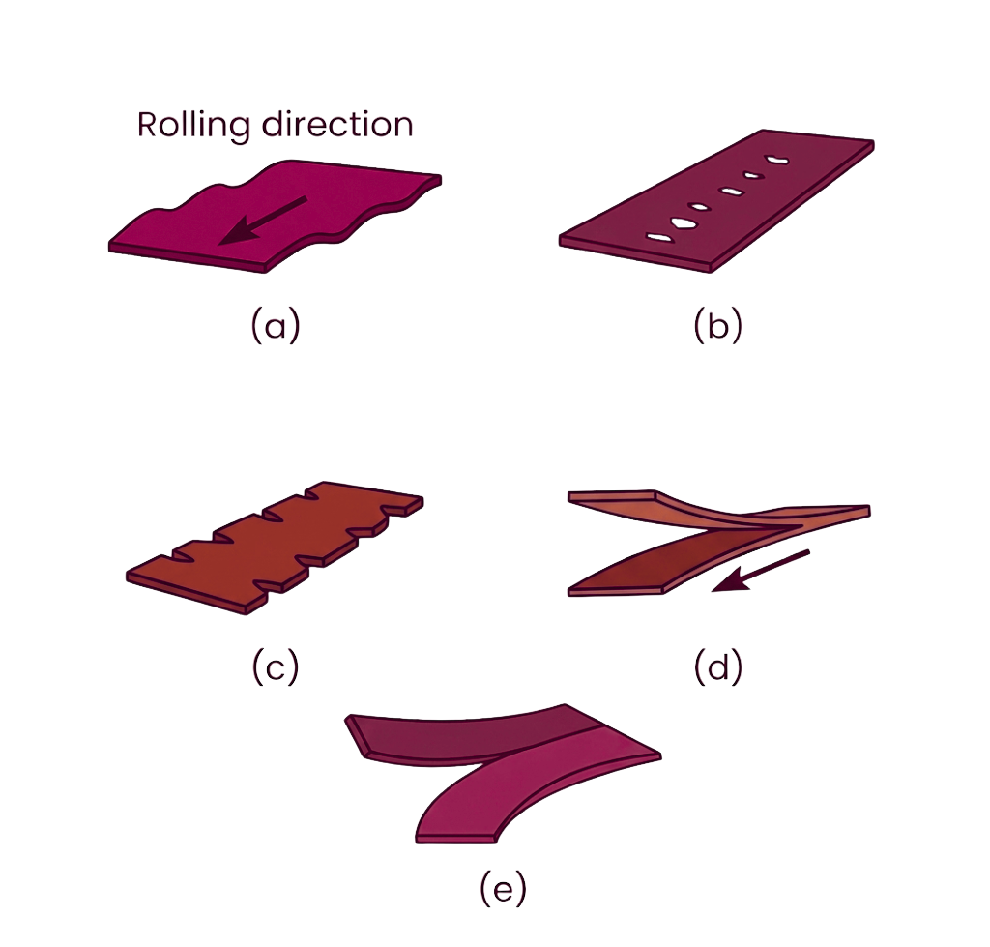
Defects in Flat Rolling
  Defects in rolled plate and sheet may be surface defects (scale, rust, scratches, gouges, pits, cracks) or internal structural defects
  Beyond appearance, defects degrade strength, formability, and downstream manufacturing characteristics, a sheet with edge cracks will fail unpredictably in a later stamping or drawing operation
  Surface defects often trace back to inclusions and impurities in the original cast material, or to conditions in material preparation and rolling itself
Figure 13 : Typical defects in flat rolling : (a) wavy edges; (b) zipper cracks in the center of the strip; (c) edge cracks; (d) alligatoring, and (e) center split.
19

Slide 20
Wavy Edges and Zipper Cracks
  Both trace back to roll bending: treating the roll as a beam under distributed load, the rolls deflect apart more at midspan than at the ends, so the strip comes out thicker in the center and thinner at the edges
  Thinner edges must elongate more than the thicker center to conserve volume along the rolling direction, which puts the edges in longitudinal compression and the center in longitudinal tension
  Wavy edges: the edge material, under compressive stress and thinner, creates a wavy appearance near the edges. The remedy is a correct camber matched to the operating roll force.
  Zipper cracks: the center material cracks along the centerline of the strip due to the tensile force, same root cause, same remedy
Figure 14 : Wavy edges and zipper cracks
20

Slide 21
Edge Cracks and Center Split
  Both trace back to non-homogeneous plastic deformation of metal across the width.
  As the strip passes through the rolls, its height decreases, and it elongates, but it also spreads laterally. This lateral spread is resisted by friction and the adjacent material. Resistance to lateral spread is strongest at the strip's centerline and weakest at the edges. Because the center resists spreading further, it compensates by elongating more in the rolling direction than the edges do.
  Edge cracks: the edges, spreading more freely and elongating less, develop irregular strain that opens cracks along the free edge
  Center split: in more severe cases, the same non-uniform flow opens a crack running along the strip's centerline
  Because the quality of the edges of the sheet is important in sheet metal forming operations, edge defects in rolled sheets are often removed by shearing and slitting operations.
Figure 15 : Edge cracks and center split
21

Slide 22
Alligatoring, Folds, Laminations
  Alligatoring: rolling reduces height while increasing length, but friction at the roll-strip interface means the top and bottom surfaces elongate less than the material at the mid-thickness of the strip. In severe cases this differential elongation ruptures the strip along its length into an upper and lower half, resembling the open mouth of an alligator
  Folds: occur when the reduction taken per pass is too low, the strip surface folds over on itself rather than deforming through its thickness
  Laminations: internal layering caused by unwelded porosity or non-metallic inclusions carried over from the original ingot. If the ingot has piping containing oxidized or non-metallic material, that material cannot weld shut during rolling, and it elongates along with the sound metal, producing an internal layered defect
  Remedy for all three: discard the affected portion of the ingot and roll only sound material, these are defects of the starting stock, not correctable by adjusting the rolling pass itself
Figure 16 : Aligatoring
22

Slide 23
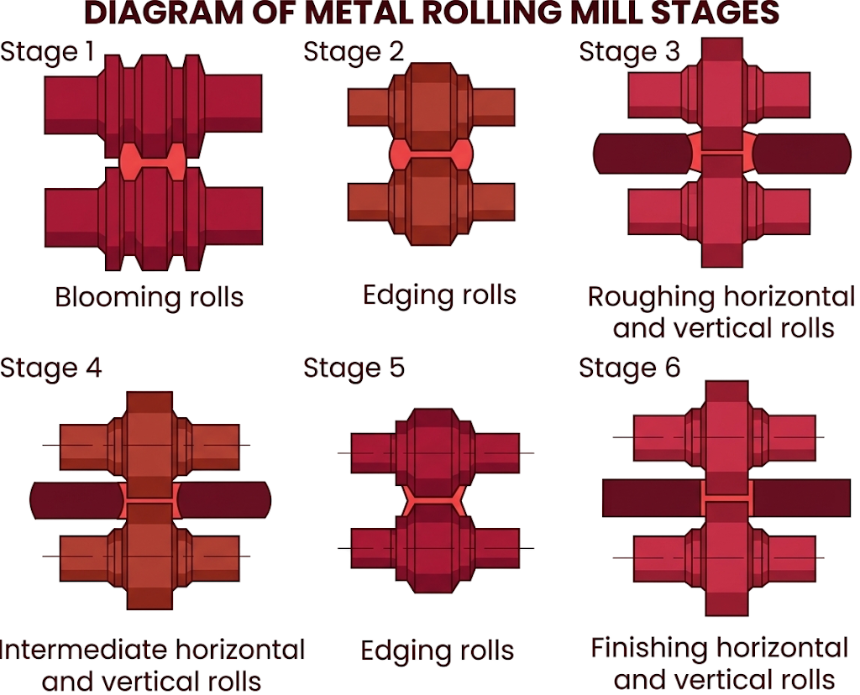
Shape Rolling
Definition: Shape rolling (profile rolling) forms square or round cross-section stock into structural profiles, channels, I-beams, railroad rails, or solid bars by passing through a sequence of specially designed, contoured rolls.
  Carried out at an elevated temperature for the primary structural sections above
  Cold shape rolling is also practiced, typically starting from wire stock with various cross-sections
  The following figure shows the Steps in the shape rolling of an I-beam part. Various other structural sections, such as channels and rails, are also rolled using this process.
Figure 17 : Stages in the shape rolling of an H-section part.
23

Slide 24
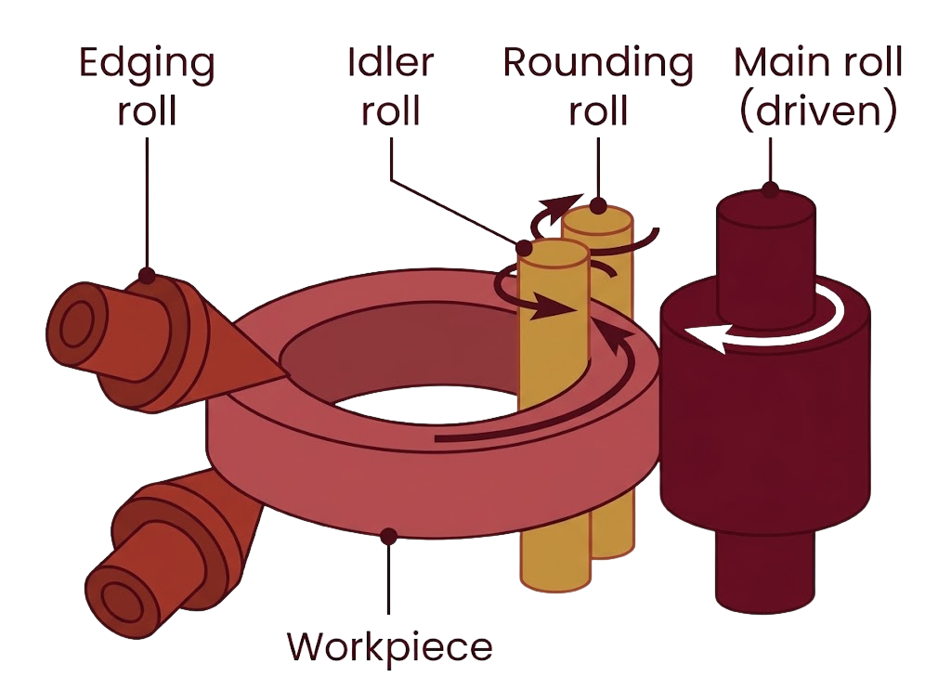
Ring-rolling
Definition: Ring-rolling reduces the thickness of a ring-shaped workpiece while simultaneously increasing its diameter, producing seamless rings without the material loss of machining from solid stock.
  Roll set: an edging roll, an idler roll, a rounding roll, and a driven main roll, working together on the ring's cross-section
  Thickness reduction and diameter increase are linked; reducing wall thickness necessarily grows the ring's outer diameter, since the material has to go somewhere
  Applications include bearing races, flanges, and gear blanks, wherever a seamless, radially uniform ring is required
Figure 17 : Ring-rolling
24

Slide 25
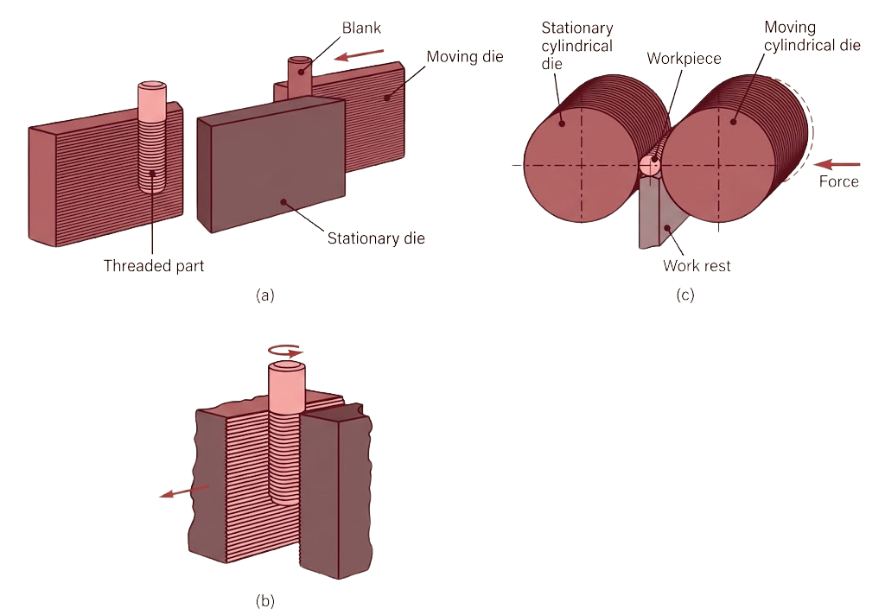
Thread Rolling
Definition: Thread rolling is a cold-forming process that forms straight or tapered threads on a round rod or wire blank by pressing it between grooved dies, without removing any material.
  Two configurations:
    Reciprocating flat dies: threads form progressively with each stroke of a pair of flat dies
    Two-roller dies: cylindrical dies rotate against the workpiece, forming the thread continuously
  High-volume and economical production method, standard for threaded fasteners (bolts, screws)
Figure 17 : Thread-rolling processes : (a) and (b) reciprocating flat dies;
(c) two-roller dies. Threaded fasteners, such as bolts, are produced economically by these processes at high production rates.
25

Slide 26
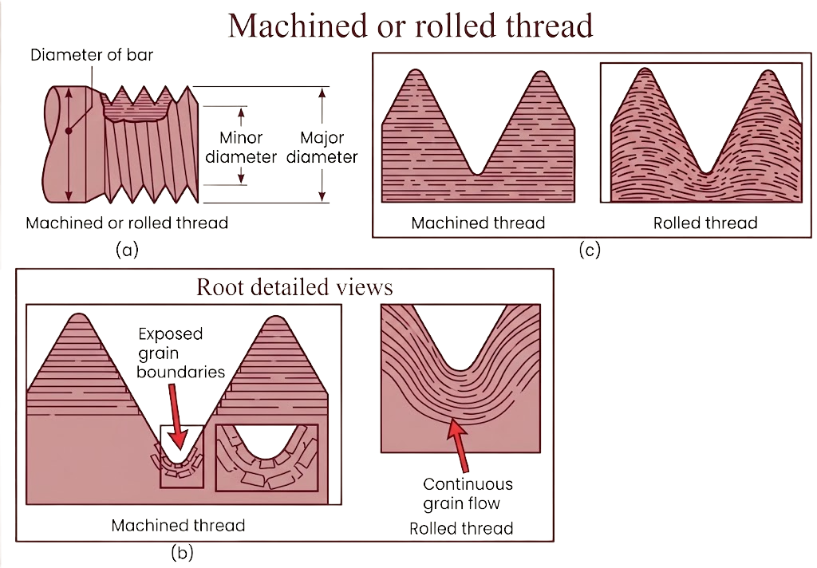
Machined vs. Rolled Threads
  The distinction is in how the thread's grain flow is affected: machining cuts through the metal's existing grain structure, rolling deforms it around the thread profile without severing it.
  Machined thread: grains are cut, exposing grain boundaries at the thread root, a natural stress-concentration and crack-initiation site
  Rolled thread: grains flow continuously around the thread profile, following the thread contour. This continuous grain flow, combined with the cold working (strain hardening), gives rolled threads meaningfully higher fatigue strength than machined threads of the same nominal dimensions.
Figure 18 : Comparison between machined and rolled thread : (a) common features of threads; (b) grain flow in machined and rolled thread; (c) close up view of grain flow
26

Slide 27
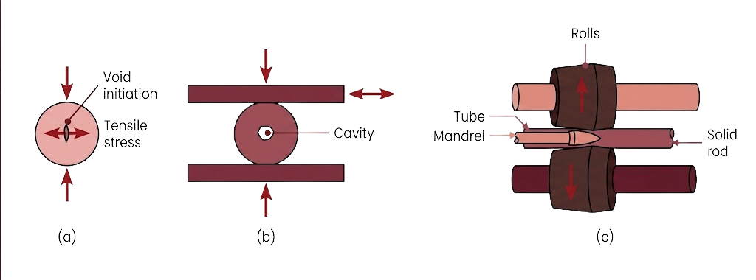
Rotary Tube Piercing
Definition: Rotary tube piercing is a hot-working process that produces long, thick-walled seamless pipe and tubing.
  Mechanism: When a round bar is subjected to radial compressive forces, tensile stresses develop at the bar's center. Subjecting the bar to cyclic compressive stress, achieved by rotating it between angled rolls, repeatedly reopens and grows this central tensile zone until a continuous cavity forms along the bar's axis.
  That cavity becomes the bore of the seamless pipe, no welding, no seam.
Figure 18 : Cavity formation in a solid, round bar and its utilization in the rotary tube-piercing process for making seamless pipe and tubing.
27

Slide 28
Thank you

